Slide 1
UTA Event Mapper
Team 10 Mason Jeff Kahn

Slide 2
Github
https://github.com/mtb9515/UTA-Event-Mapper

Slide 3
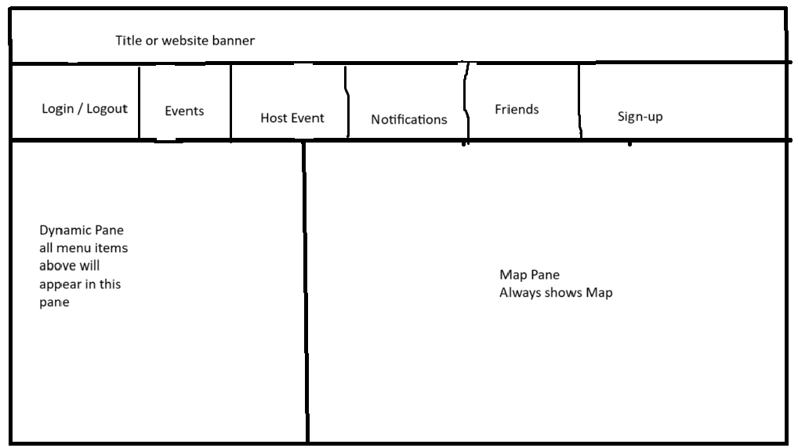

Slide 4
Competitors
Google Maps
Global scale Map, organized by locations
Larger scale, less specialized, non exclusive, location oriented rather than event oriented
https://events.uta.edu/
College hosted site with college related events and map links
Less user friendly, no Map included in base UI, event hosting controlled

Slide 5
Priority Features - High Risk / Core components
Account Creation
UTA email required/verified for signup
Simple account creation required to begin hosting events
Login with Email and PW
Map
Displays Map centered on UTA, Displays Pins of hosted events
Can zoom and Scroll and tp Pins for info

Slide 6
Priority Features - High Risk / Core components
Create Events
Place Pin on Map for event location
Mandatory: Event Name, Time (1 week limit to start), Location Description, Host Info
Optional: RSVP option, Links (organization / socials), Private (creates list to send Email invite, account not required)
View Events
Viewing own event - Option to edit > reopens event creation UI
Viewing others events - Shows relevant Event INFO, RSVP if possible, list of Friends RSVP’d (implemented after friends list)

Slide 7
Important Features
Notifications
Friend requests
RSVPs to your events
Event reminders
Friend hosted events
Private event invites
Friends List
List of Names / Email addresses
Add friend bar with input for email address

Slide 8
Important Features
Event List
Top section displaying currently ongoing events
Bottom section displaying chronologically sorted upcoming events

Slide 9
Features with potential
View map and events without account
Limited interaction
May be very simple to implement
Event Filters
Filter events using a date/time or range of dates/times
Filter/search for events hosted by user email
Categorized events
Use different colors or shape for map pins

Slide 10
Risk (estimates) Probability Hour cost RE
Lack of experience 50% 30 15
Version control mistakes 50% 20 10
Absent Teammates 25% 20 5
Map API incompatible w/ vision 30% 10 3
Database incompatible w/ vision 15% 20 3
Web hosting issues 50% 4 2
Finding Users 25% 4 1

Slide 11
Risk Mitigation
Lack of experience
Version Control Mistakes
Absent teammates
Identify deficiencies and spend time self learning using tutorials or AI instruction
Group member with most Github experience directs version control management
Ongoing endeavor to include and communicate with all members

Slide 12
Risk Mitigation
Map API incompatible with vision
Web Hosting Issues
Database incompatible w/ vision or usage change
Research, explore, compare map solutions early on, have backup plan
Explore web hosting options early on before implementation required
Find backup plan for database service

Slide 13
Risk Mitigation
Finding users
Event hosts needed to gain website traffic and momentum
Seek users among classmates
Solicit classmate discords/teams/group chats
Invite event hosts around campus to try our app after launch

Slide 14
Users
UTA Students and Faculty
Anyone with a UTA student or faculty email can get validated to create an account
Account required to Host events, add friends, RSVP
UTA Visitors
The map and events can be viewed without signing up
This allows UTA visitors without an account to view events with limited feature access

Slide 15
What WE Are Not Making (Subject To Change)
Elaborate profile pages
Android/Iphone/mobile application
A service for users outside of UTA
An advertising platform

